Slide 1
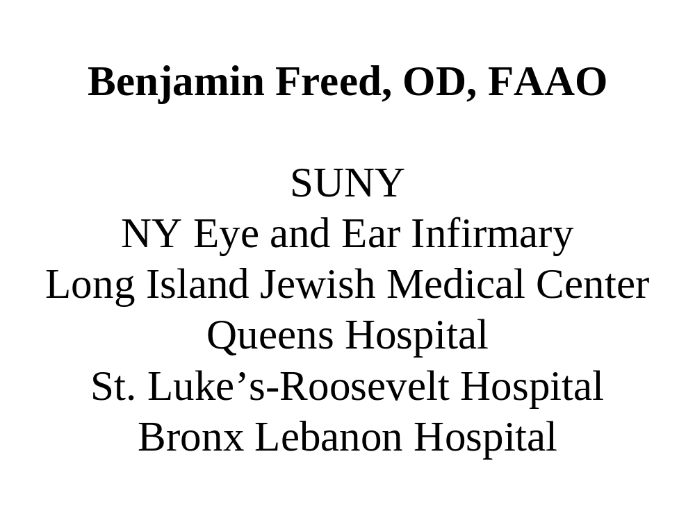

Slide 2
Legal Blindness
  Data collected from the National Health Interview Survey on Disability (1994-95) indicate that approximately 1.3 million persons reported legal blindness (0.5%) (cited in American Foundation for the Blind, 2001).
Light Perception or Less
  An estimated 20% of legally blind individuals have light perception or less representing an estimated 260,000 individuals (American Foundation for the Blind, 2001).

Slide 3
  The prevalence of self-reported vision impairment increases with age.
  The following report some form of vision impairment:
  15% (9.3 million) Americans age 45-64 years; 17% (3.1 million) age 65-74 years and 26% (4.3 million) age 75 years and older

Slide 4
As part of its Global Initiative for the Elimination of Avoidable Blindness, Known as “Vision 20/20” The World Health Organization has identified uncorrected refractive error as one of 5 preventable and treatable causes of global blindness, the others being cataract, trachoma, onchocerciasis, childhood blindness.

Slide 5
Case history
65 year old with AMD OU, no glasses
Entering vision 20/200 OD and OS
REFRACTIVE ERROR OVERLAID ON TOP OF THE RETINAL DEFECT!!!!!!
OD: +2.50sph 20/80
OS: +3.00sph 20/100

Slide 6
Assess acuity correctly!!
45 y/o Hatian female, MVA with RGs OU

Slide 7
Order of acuity assessment
Snellen fraction at 20 feet, letters, numbers, tumbling “E”, pictures
Snellen fraction, hand held chart brought close
Finger counting, mimicry
Light projection
Light perception
NLP

Slide 8
Distance visual acuity targets
EDTRS (Early Treatment Diabetic Retinopathy Study)
Projector….. Letters, pictures
hand –held
Video display
Object identification
Mimicry
Tumbling E, tumbling hand chart

Slide 9

Snellen letters are constructed so that the size of the critical detail (stroke width and gap width) subtends 1/5th of the overall height. To specify a person's visual acuity in terms of Snellen notation, a determination is made of the smallest line of letters of the chart that he/she can correctly identify. Visual acuity (VA) in Snellen notation is given by the relation:
VA = D'/D
where D' is the standard viewing distance (usually 6 metres) and D is the distance at which each letter of this line subtends 5 minutes of arc (each stroke of the letter subtending 1 minute)

Slide 10


Slide 11
Case history
Age 52 M, small corneal opacity OD,
enucleated OS
Entering VA = 20/800, OD, variable
Malingering, BVA= 20/40 (+1.00 –1.50x80)

Slide 12
the malingerer
Inconsistent vision over time
Psychiatric history
Evidence of secondary gain
Negative physical findings
Uncooperative
Letter from attorney
Patient under stress
Current terminology : Non organic

Slide 13
Case history
Age 55 diabetic female with BDR
Wearing OD +1.50 –050 X 95 20/60
OS +1.75 –075 X 110 20/80
with +250 add
Manifest OD +275 –050 X 90 20/30
OS + 300 –075 X100 20/40

Slide 14
CASE HISTORY this week
age 60 female, 20/400 in OD, NLP OS
History of uveitis, cataract, synechia, pupil bound down and miotic. Looks like a 20/400 eye.
BVA= 20/20 with –3.00 sphere

Slide 15
Case History
91 y/o male, entering VA= F.C., OU.
CC: OD has gotten worse recently, OS “bad for years”
OD: pseudophakia, recent sub retinal hem
OS: uncorrected aphakia X 2 years
OS refraction: +12.00, 20/20!!!

Slide 16
Post-surgical problem
Manifest: OD: +3.50 -1.25X 85 20/25
OS: plano -0.75 X 90 20/25+

Slide 17
Case history
Male, age 80, unhappy with his glasses, was told by 2 doctors that his glasses were good
Enters with OD: -2.50, -1.00 X 90 20/40
OS: -2.25, -1.25 X 85 20/40
+2.50 add
Manifest OD: -1.50, -1.00 X 90 20/40
OS: -1.25, -1.25 X 85 20/40

Slide 18
Case history
Age 87 male, blind in the right eye
OS Refraction: +1.00 –2.50 X 90, 20/20-
Wearing +1.00-2.50 X 90, add +250, but complaining

Slide 19
Referral to low vision clinic:
BVA of 20/50 or worse
Reading difficulty
Field loss/mobility problems
Don’t wait until VA is 20/600!
Difficult refractions
Difficulties with activities of daily living

Slide 20
Measures of visual function
Acuity
Binocularity
Color
Contrast sensitivity
Field

Slide 21
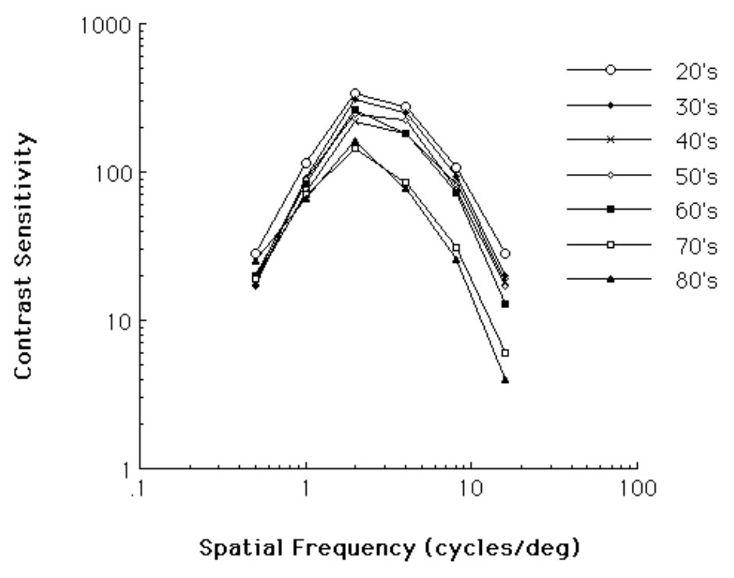
contrast sensitivity function
<>
20/200(6cycles per degree)
(20/20=60cpd)

Slide 22
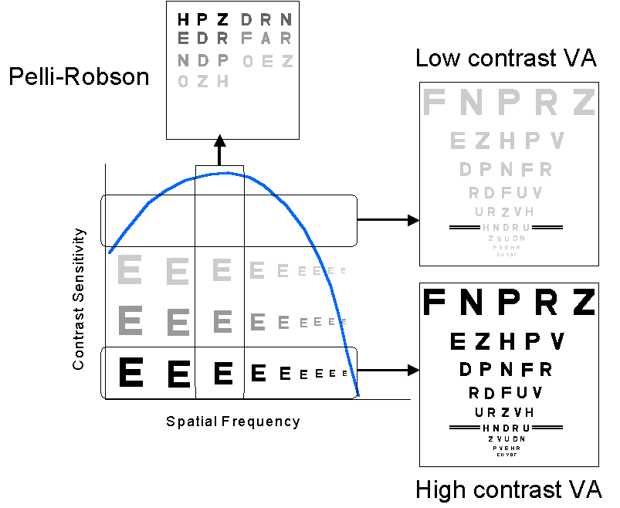
contrast sensitivity function

Slide 23
Low vision case history
Near vision: reading, writing, food preparation, sewing, insulin injection, cell phone
distance symptoms: faces , bus and street signs, blackboard, TV
Intermediate: computer, cash register ADL and mobility, driving
vocational, educational, family/social

Slide 24
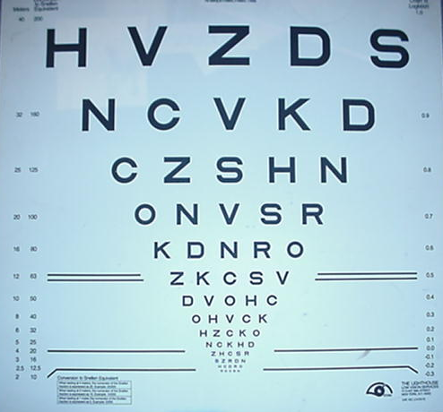
Bailey-Lovie, ETDRS, logMAR acuity chart
1. equal level of difficulty of lines and letters
2. Log base 10 of angular subtense(logMAR)
3. Doubling of size every third line

Slide 25
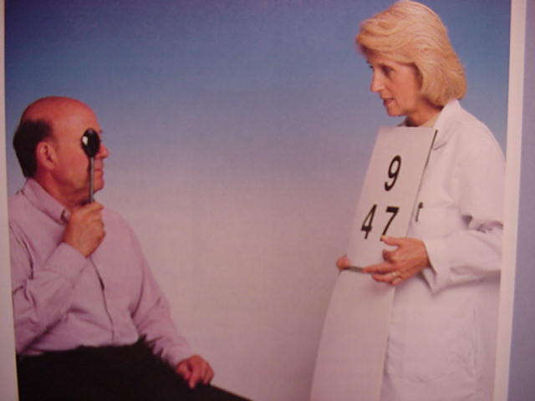

Slide 26



tumbling hands
100 feet
50 feet
30 feet

Slide 27
Retinoscopy for low vision or elderly patients
Dark room
No phoropter; use trial lenses
Move off axis if needed
Shorter and variable “working distances”

Slide 28
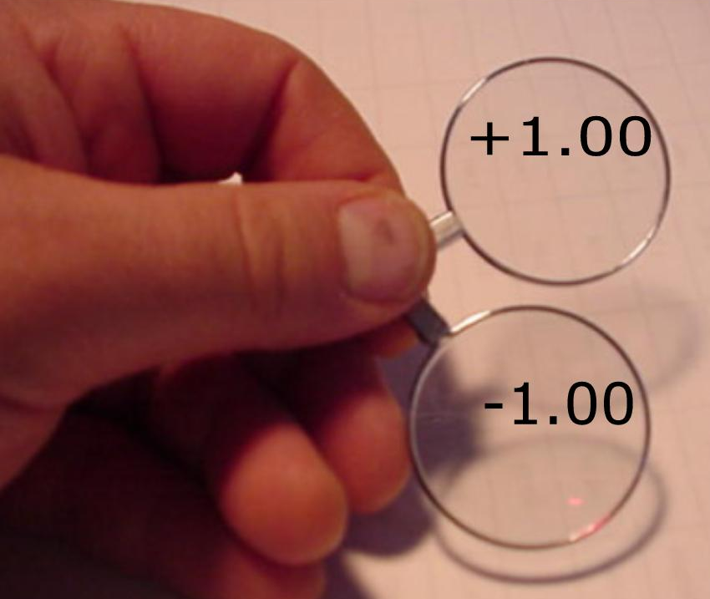
SUBJECTIVE TEST FOR LOW VISION PATIENTS
The visually impaired eye is insensitive to small dioptric changes, so show a larger lens interval. The smallest amount of lens change needed to produce an appreciation of change in blur is known as the “JUST-NOTICABLE-DIFFERENCE interval”, or the “JND”.The rule of thumb to determine the JND is the denominator of the 20 foot acuity.
Example: 20/200…...show an interval of 2.00 diopters to a person who has a JND of one diopter:

Slide 29
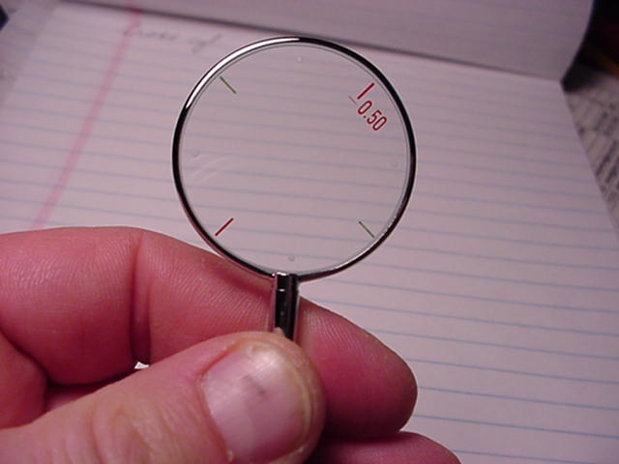
High power cross cylinder

Slide 30
Where to by JCCs
Woodlyn Optical
800 331 7389

Slide 31
Driving in New York State: three levels
1. 20/20 to 20/40: no restrictions
2. 20/50 to 20/70: 140 degree field required
3. 20/80 to 20/100: 140 degree field required, and use of bioptic telescope.

Slide 32
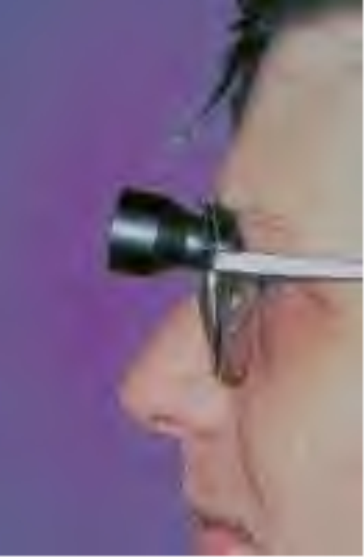
bioptic telescope

Slide 33
Legal blindness criteria
BVA=20/200 or worse in the better eye, or….
Visual field of less than 20 degrees in the better eye

Slide 34
Entitlements for the legally blind through the CBVH
Home rehab training in activities of daily living, or “ADL”
Vocational rehab
Educational services
Orientation and mobility training (O&M)
Recreational services
CBVH in NYC…212-825-5716

Slide 35
After determining the best corrected VA, now what can we do to enable reading?
i.e., How much of an add does the patient need to read small print?….
Answer: determine the predicted add: the amount of add needed by a patient to read small print as predicted by their best corrected visual acuity

Slide 36
To determine the predicted add, use the Kestenbaum Formula: Predicts the add needed to see small print for the low vision patient:
INVERT THE BEST CORRECTED ACUITY
Example: if BVA=20/400, the add needed to read small print is 20 diopters

Slide 37
Deriving the Kestenbaum formula. Create a ratio:
test distance = x
size of letter seen 1M
Example: BVA= 20 = 1 = x
400 20 1M
--------------------------------------------------------
therefore; x = .05M
What lens focuses at 5 centimeters?

Slide 38
What is predicted add for:
BVA =20/500
BVA=20/150
BVA= 2M/16
BVA= .4M/1.2

Slide 39
Low vision optical aids FOR READING provide equivalent power of the predicted add
Spectacles
Hand magnifiers
Stand magnifiers
Reading telescopes

Slide 40
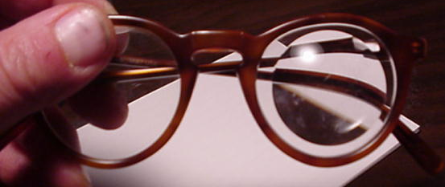
Microscopic spectacle, aspheric lenticular

Slide 41
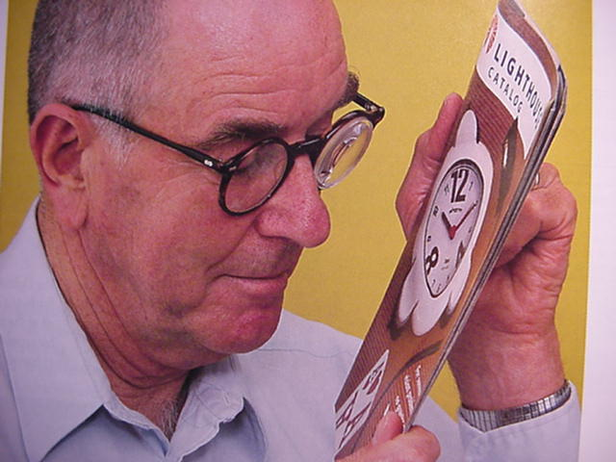
spectacle reading addition; single vision or bifocals

Slide 42
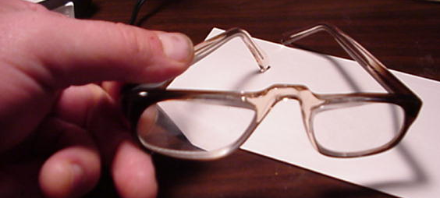
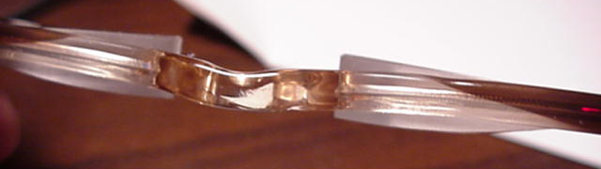
Prism half-eye

Slide 43
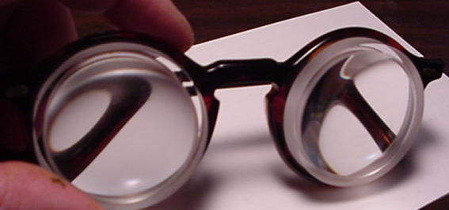
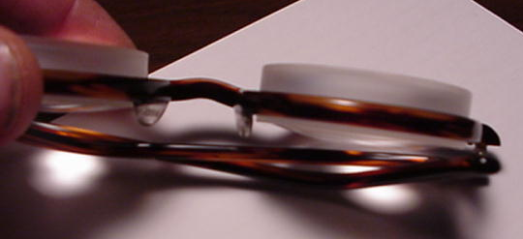
Microscopic doublet

Slide 44
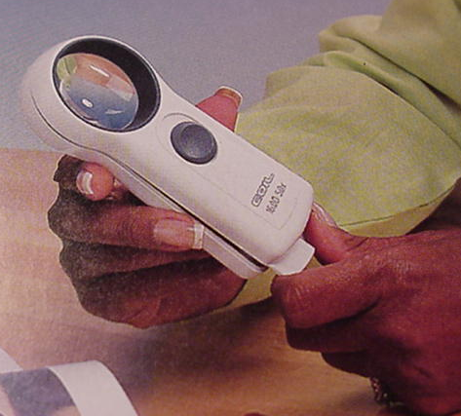
Illuminated hand magnifier

Slide 45
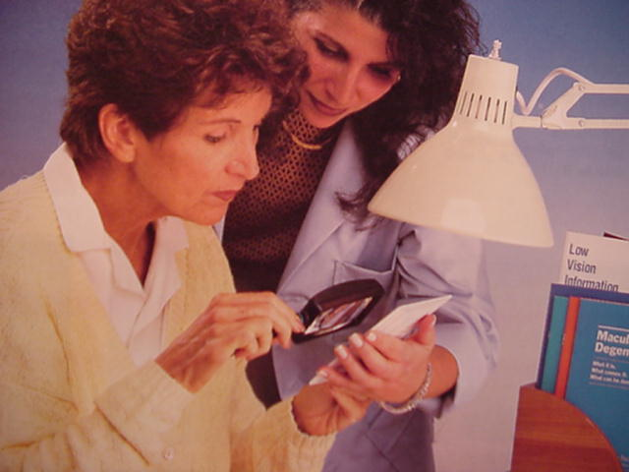
hand held magnifier

Slide 46
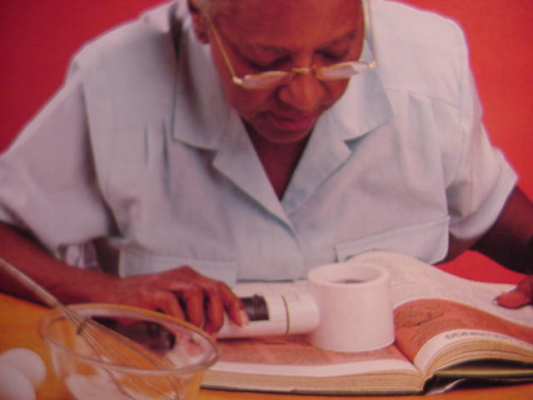
illuminated stand magnifier

Slide 47
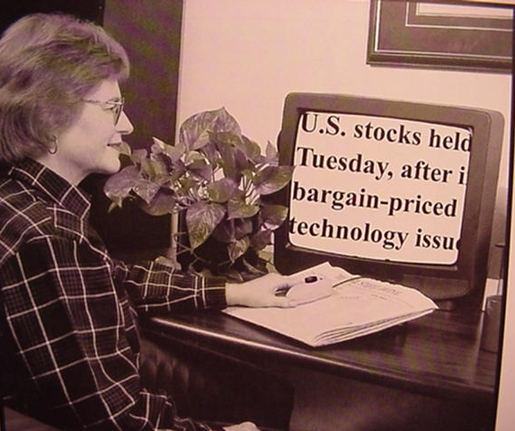
Low cost hand-held closed circuit video camera

Slide 48
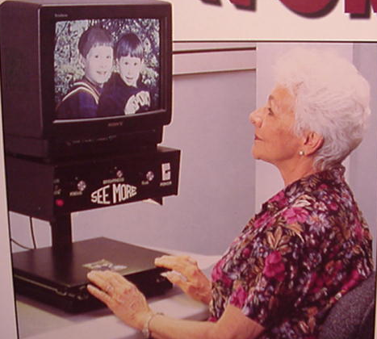
closed circuit video reader

Slide 49
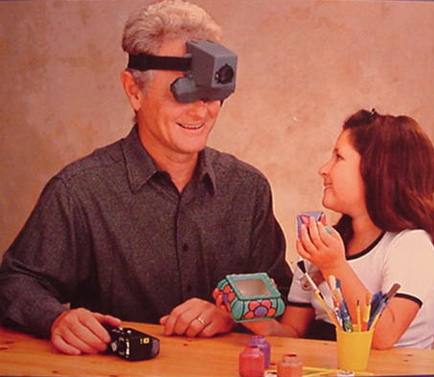
Head-borne closed-circuit video systems..the “Jordy”

Slide 50
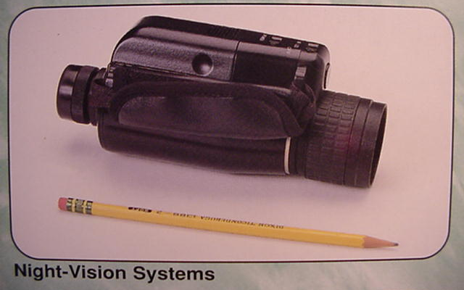

Slide 51
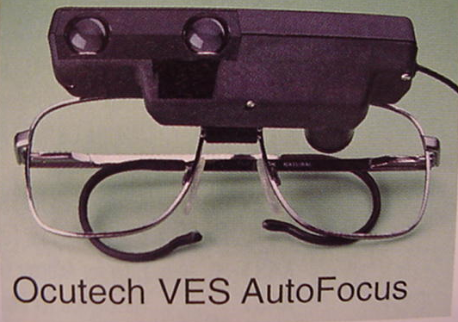
auto-focus telescope

Slide 52
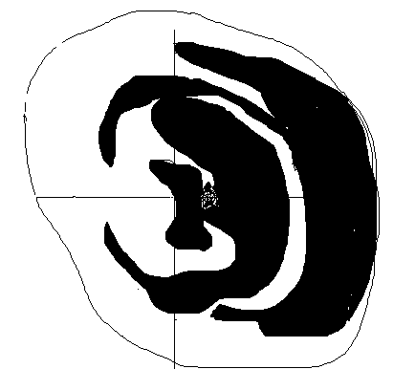
Case history:
59yo M., glaucoma, monocular, BVA= 20/800

Slide 53
Case history
69 y/o male, presents saying he has macular degeneration, has had recent visits for FA
Entering VA= 20/200, 20/400
Retinoscopy indicates myopic shift
-2.50sph additional myopic correction yields 20/40 OU

Slide 54
Case history
Monocular patient. Remaining eye has IK. No red reflex. Irregular K. VA=20/800
Accepts +7.00 sphere to BVA of 20/150.
Reading RX?

Slide 55
Case history
75 year old female with AMD OD>OS, and pseudophakia OU. Has no DV RX and her old NV RX is OTC +3.00 sph.
Entering acuity is OD 20/200 and OS 20/100
OS improves on refraction to 20/30+ with +2.00 –2.00 X90…

Slide 56
Case history
Age 60 F. bilateral macular holes
Report says BVA=20/200
Refracts to –2.00 sph OU. BVA = 20/80
What reading prescription?

Slide 57
Case history
39 yo male, keratoconus, monocular, has no glasses
Entering va= 20/400
Manifest= -2.00-350 X 25, 20/100

Slide 58
Case history
Age 41 F, PDR, s/p PPV OS
Enters 20/60 and 20/200 with no glasses, and can’t read
Refraction: OD: +1.50 –1.00 X 45….20/40
OS -2.00 sph, 20/100
Vascular effect on cilliary body?

Slide 59
Common clinical low vision refractive entity:
Long-standing age-related cataract in combination with glaucoma
can find up to 10 diopters of myopic shift. See no retinoscopy reflex.
Take uncorrected near acuity at a few inches

Slide 60
Case history
Age 59 F, POAG, IOL OU.
Entering acuity is 20/400 and 20/ 300 , has no glasses.
BVA OD = 20/60 with –200 sphere
BVA OS = 20/40 with +300 – 550 X 90
Needs vocational bifocals. Rx with slab-off prism.

Slide 61
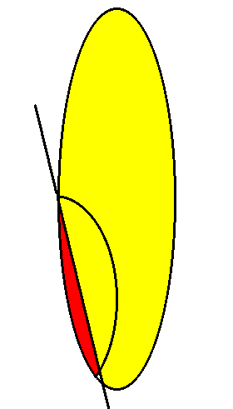
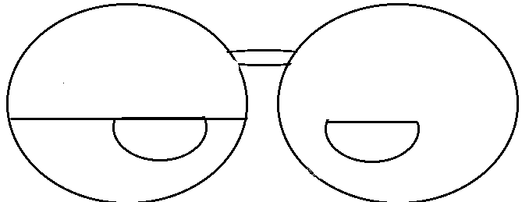
Slab-off prism

Slide 62
Common Refractive dilemma
Presurgical wearing: OD +200 sph, 20/50
OS +200 sph, 20/100
Post surg refraction OS +3.00 sph 20/20
OD plano sph 20/20

Slide 63
Case history
40 yo female with stromal keratitis in her remaining eye
Entering VA is FC at 5 feet
No retinoscopy reflex
Accepts +7.00 sphere to 20/200

Slide 64
Case history
Age 59 female, entering VA is 20/400 and HM
“no organic cause found”…neuro-oph
psychiatric history
Retinoscopy: OD: -150 sph….20/30
OS: -150 sph….20/50

Slide 65
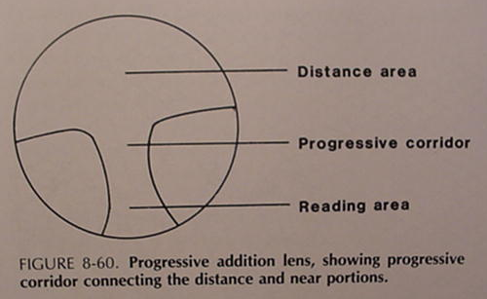
Progressive lenses

Slide 66
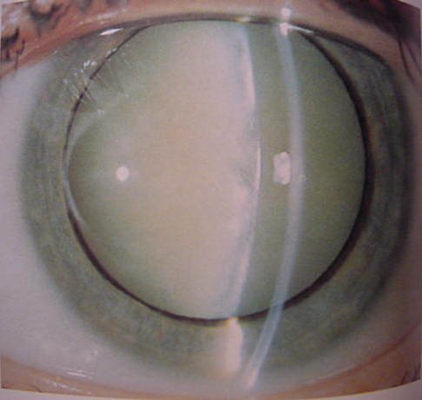

Slide 67
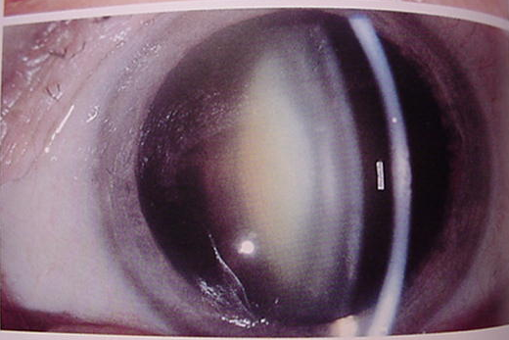

Slide 68
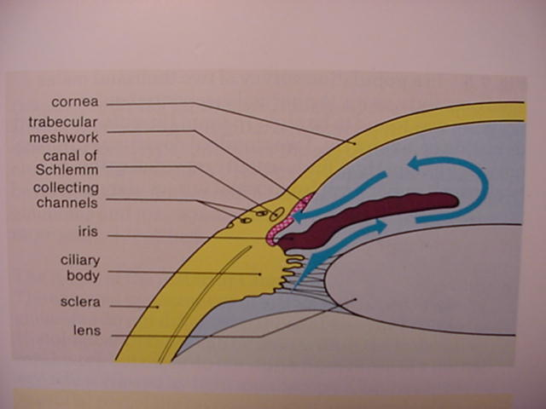

Slide 69
Slab-off prism

Slide 70
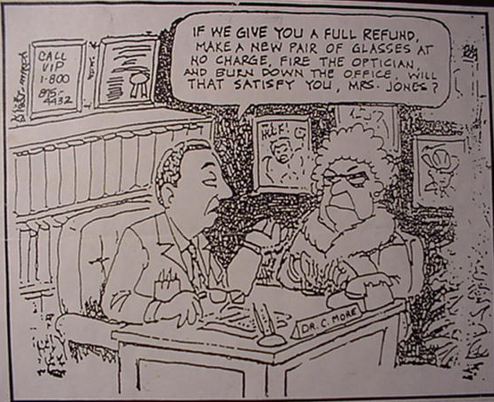

Slide 71
High power cross cylinder

Slide 72
Case history
Age 52 M, small corneal opacity OD,
enucleated OS
Entering VA = 20/800, OD, every visit since 1996.
Malingering, BVA= 20/40 (+1.00 –1.50x80)

Slide 73
Case History
91 y/o male, entering VA= F.C., OU.
CC: OD has gotten worse recently, OS “bad for years”
OD: pseudophakia, recent sub retinal hem
OS: uncorrected aphakia X 2 years
OS refraction: +12.00, 20/20!!!

Slide 74
Case history
Age 41 F, PDR, s/p PPV OS
Enters 20/60 and 20/200 with no glasses, and can’t read
Refraction: OD: +1.50 –1.00 X 45….20/40
OS -2.00 sph, 20/100
Vascular effect on cilliary body?

Slide 75
To determine the predicted add, use the Kestenbaum Formula: Predicts the add needed to see small print for the low vision patient:
INVERT THE BEST CORRECTED ACUITY
Example: if BVA=20/400, the add needed to read small print is 20 diopters

Slide 76
Case history
69 y/o male, presents saying he has macular degeneration, has had recent visits for FA
Entering VA= 20/200, 20/400
Retinoscopy indicates myopic shift
-2.50sph additional myopic correction yields 20/40 OU

Slide 77
What is predicted add for:
BVA =20/500
BVA=20/150
BVA= 2M/16
BVA= .4M/1.2

Slide 78
Microscopic spectacle, aspheric lenticular

Slide 79
Common clinical low vision refractive entity:
Long-standing age-related cataract in combination with glaucoma
can find up to 10 diopters of myopic shift. See no retinoscopy reflex.
Take uncorrected near acuity at a few inches

Slide 80
Prism topics
measuring prismatic power of spectacles
prescribing prism
Types of prism:
Decentration
Ground in
Fresnel press-on
Slab-off
Risley prism: continuously variable

Slide 81
Types of prism
Decentration
Ground in
Fresnel press-on
Slab-off
Risley prism: continuously variable

Slide 82
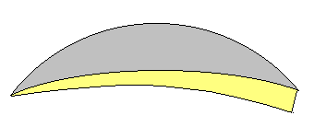

Slide 83
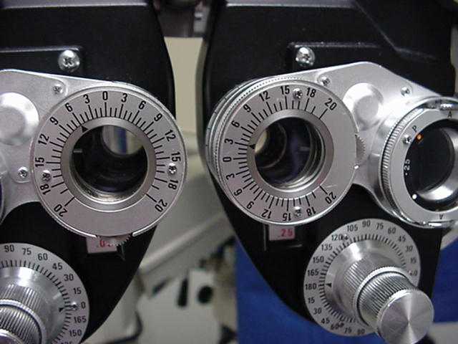

Slide 84
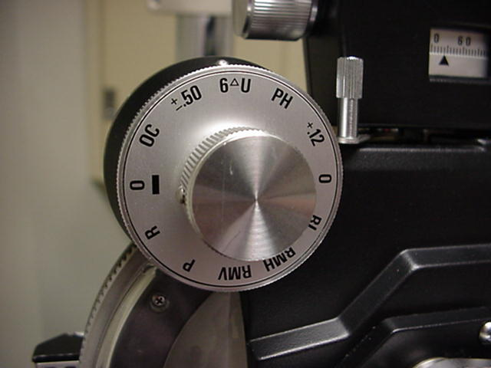

Slide 85
Effective prism of spectacles:
Measurement:
1. compare PD(pupillary distance) and distance between optical centers of glasses ( DBOC)
2. Measure amount of prism directly at pupillary position

Slide 86
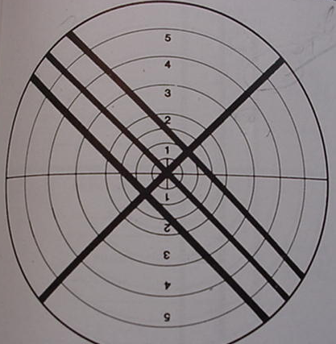
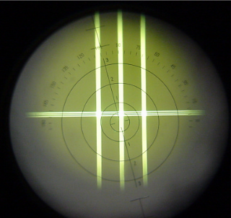
Measuring prism in the lensometer

Slide 87
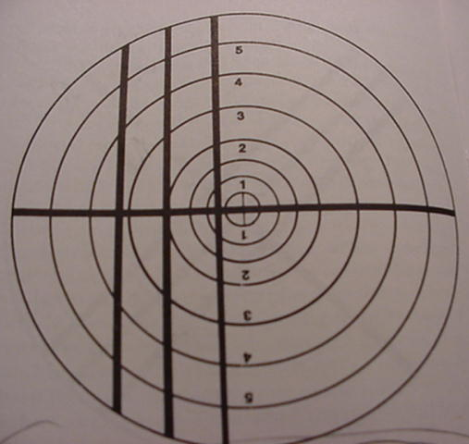

Slide 88
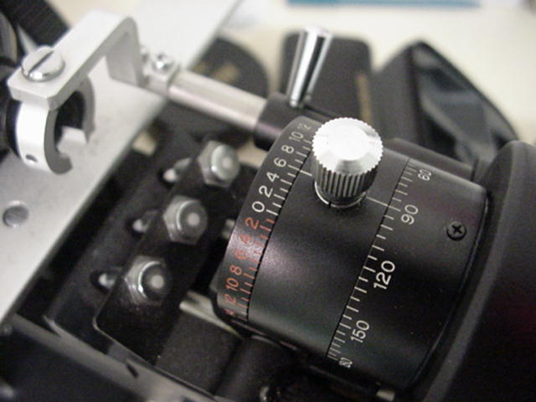

Slide 89
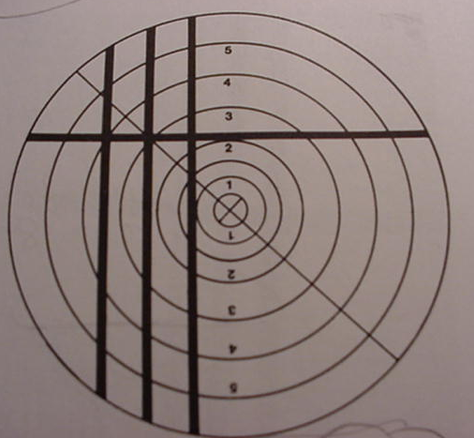

Slide 90
2 Induced phoria examples
PD= 58 RXOD +3.00sph
DBOC= 68 OS +4.00 –1.00 X 180
-----------------------------------------------
PD= 60 RXOD -5.00sph
DBOC= 56 OS –1.00 -3.00 X 90

Slide 91
Induced vertical prism causes induced anisophoria:
Three or four diopters of vertical prism is maximum that can be fused, or tolerated in some individuals
Corrected anisometropia in the vertical meridian induces vertical prism

Slide 92
Examples of vertical anisometropia
Rx: OD: +4.00 –3.00 X 90
OS: +4.00 –3.00 X 180
Rx: OD: +3.00 sph
OS: +1.00 +2.00 X 180
Rx: OD: -3.00 -200 X 180
OS: plano sph -200 X 180
Rx: OD: +1.00 -100 X 90
OS: -100 sph
Rx: OD: -7.50 sph
OS: -4.50 –3.00 X 180

Slide 93
Induced vertical prism causes induced anisophoria:
Two or three diopters of vertical prism is maximum tolerated in some individuals
Corrections include:
2 pair, SV(not bifocal)
Contact lens
Slab off prism
Dissimilar bifocal segments
Modify the DV RX

Slide 94
Slab-off prism

Slide 95
Case history
Age 59 F, POAG, IOL OU.
Entering acuity is 20/400 and 20/ 300 , has no glasses.
BVA OD = 20/60 with –200 sphere
BVA OS = 20/40 with +300 – 550 X 90
Needs vocational bifocals. Rx with slab-off prism.

Slide 96
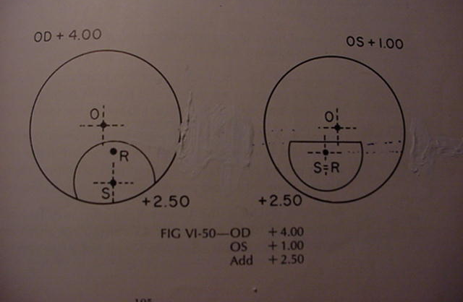
Dissimilar bifocal segments

Slide 97
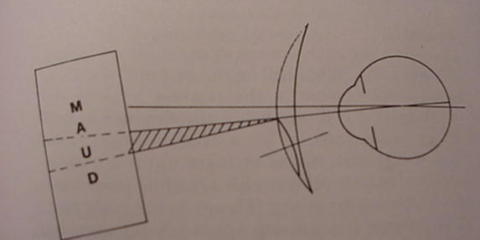
Image jump at segment line

Slide 98
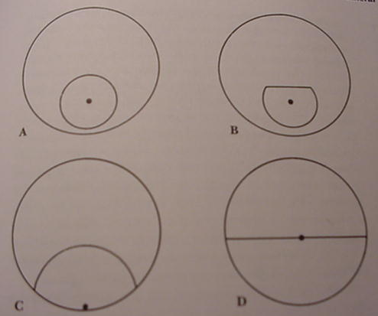
Positions of the segment optical centers

Slide 99
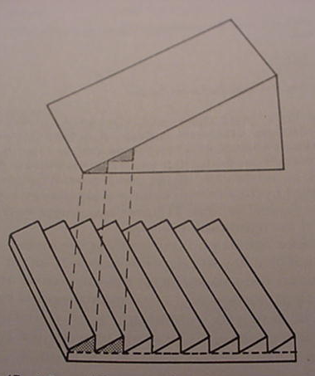
Fresnel prism

Slide 100
Prism Relocation for Hemianopia
Place prism base in the direction of the scotoma

Slide 101
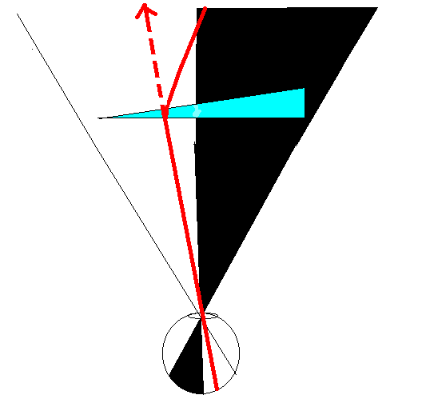

Slide 102
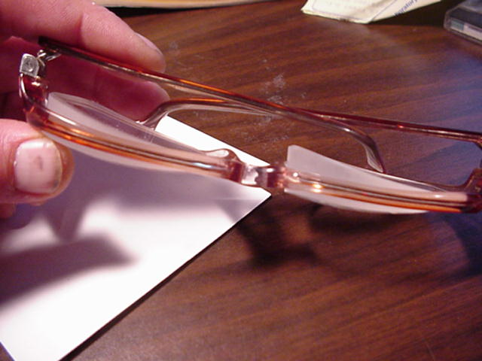
Prism for image relocation

Slide 103
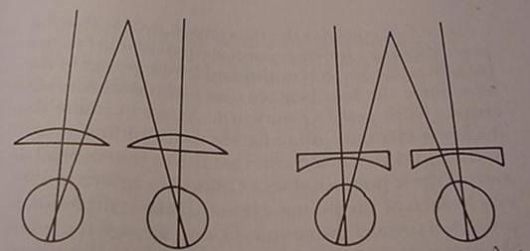
Prismatic effect of convergence

Slide 104
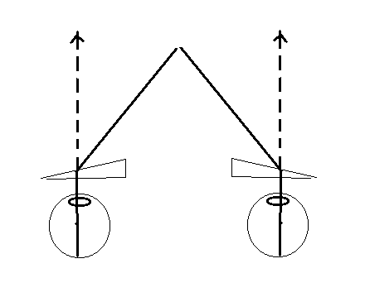

Slide 105
Pearls
How to prescribe simple adds | Use of high cross cylinders | No phoropter for retinoscopy | Variable distance retinoscopy
Scissors motion in retinoscopy: Observe the center | Identifing the malingerer | Relate distance and near acuities | Steps in subjective refraction
Just-noticable-difference lenses | Do not postpone glasses | Kestenbaum’s formula | Driving laws

Slide 106
Low Vision - When ordinary eye glasses, contact lenses or intraocular lens implants cannot provide sharp sight, an individual is said to have low vision . . . although reduced central or reading vision is common, low vision may also result from decreased side (peripheral) vision, a reduction of loss of color vision, or the eye's inability to properly adjust to light, contrast or glare.
Legal Blindness - Federal Regulation establishes Legal Blindness: . . . when the best vision obtained in the better eye, is 20/200 or less, or when, despite the activity attained the field of vision of the better eye is 20 degreees or less.

Slide 107
What are the leading causes of blindness?
  The leading causes of existing cases of blindness are: glaucoma, macular degeneration, cataract, optic nerve atrophy, diabetic retinopathy and retinitis pigmentosa. These causes account for 51% of all cases of blindness (National Society to Prevent Blindness, 1980).

Slide 108
  Approximately 3% of individuals age 6 and older, representing 7.9 million people, have difficulty seeing words and letters in ordinary newspaper print even when wearing glasses or contact lenses. This number increases to 12% among persons age 65 and older (3.9 million) (McNeil, 2001).

Slide 109
Prism half-eye

Slide 111
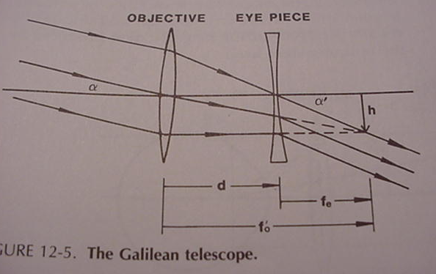

Slide 112
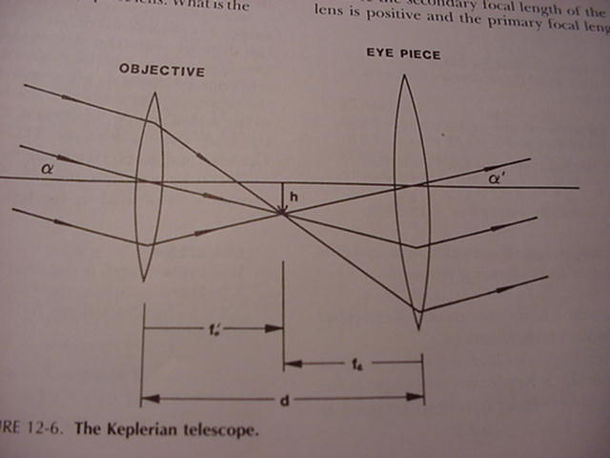

Slide 113
